Slide 1


Chapter 7: Routing Dynamically
Routing Protocols

Slide 2
Dynamic Routing Protocols
Notes:
7.1

Slide 3
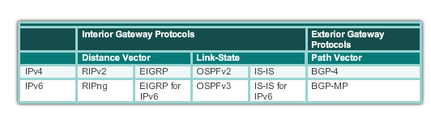
Dynamic Routing Protocol Operation The Evolution of Dynamic Routing Protocols
Dynamic routing protocols used in networks since the late 1980s
Newer versions support the communication based on IPv6
Routing Protocols Classification
Notes:
7.1.1.1

Slide 4
Dynamic Routing Protocols
Function(s) of Dynamic Routing Protocols:
Dynamically share information between routers. Learn information about remote networks and add routes to its routing tables
Automatically update routing table when topology changes.
Determine best path to a destination. Automatically finds alternate paths if needed.
The purpose of a dynamic routing protocol is to:
Discover remote networks
Maintaining accurate up-to-date routing information
Choosing the best path to destination networks
Ability to find a new best path if the current path is no longer available

Slide 5
Dynamic Routing Protocol Operation Purpose of Dynamic Routing Protocols
Main components of dynamic routing protocols include:
Data structures - Routing protocols typically use tables or databases for its operations. This information is kept in RAM.
Routing protocol messages - Routing protocols use various types of messages to discover neighboring routers, exchange routing information, and other tasks to learn and maintain accurate information about the network.
Algorithm - Routing protocols use algorithms for facilitating routing information for best path determination.
Notes:
7.1.1.2

Slide 6
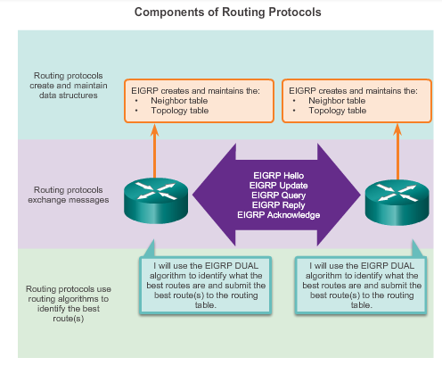
Dynamic Routing Protocol Operation Purpose of Dynamic Routing Protocols
Notes:
7.1.1.2

Slide 7
Dynamic Routing Protocol Operation The Role of Dynamic Routing Protocols
Advantages of dynamic routing
Automatically share information about remote networks
Determine the best path to each network and add this information to their routing tables
Compared to static routing, dynamic routing protocols require less administrative overhead
Help the network administrator manage the time-consuming process of configuring and maintaining static routes
Disadvantages of dynamic routing
Dedicate part of a routers resources for protocol operation, including CPU time and network link bandwidth
Sometimes static routing is more appropriate
Notes:
7.1.1.3

Slide 8
Dynamic verses Static Routing Using Static Routing
Networks typically use a combination of both static and dynamic routing
Static routing has several primary uses
Providing ease of routing table maintenance in smaller networks that are not expected to grow significantly
Routing to and from a stub network
a network with only one default route out and no knowledge of any remote networks
Accessing a single default router
used to represent a path to any network that does not have a match in the routing table
Notes:
7.1.2.1

Slide 9
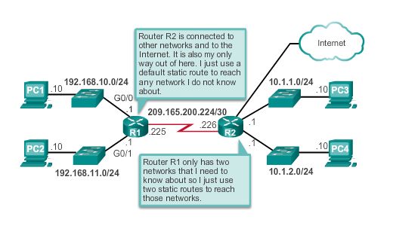
Dynamic verses Static Routing Using Static Routing
Notes:
7.1.2.1

Slide 10
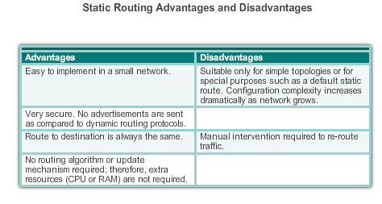
Dynamic verses Static Routing Static Routing Scorecard
Notes:
7.1.2.2

Slide 11
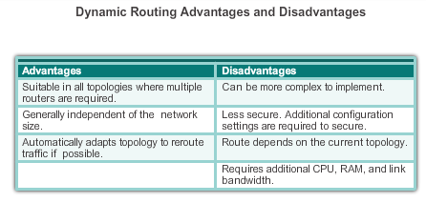
Dynamic verses Static Routing Dynamic Routing Scorecard
Notes:
7.1.2.4

Slide 12
Routing Protocol Operating Fundamentals Dynamic Routing Protocol Operation
In general, the operations of a dynamic routing protocol can be described as follows:
The router sends and receives routing messages on its interfaces.
The router shares routing messages and routing information with other routers that are using the same routing protocol.
Routers exchange routing information to learn about remote networks.
When a router detects a topology change the routing protocol can advertise this change to other routers.
Notes:
7.1.3.1

Slide 13
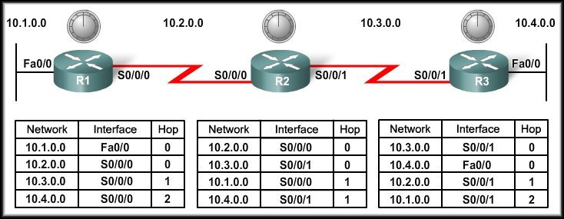
Network Discovery
Animation 7.1.3.2
Network Discovery: Is part of the process of the routing protocol algorithm that enables routers to learn about remote networks for the first time.
Router initial start up (Cold Starts)
Initial network discovery: Directly connected networks are initially placed in routing table
When a router powers up:
Knows nothing about the network topology.
Knows only the information saved in NVRAM.
Immediately Sends updates about its known networks out all ports.
No routes to remote networks.
Initially no communication possible from one network to another

Slide 14
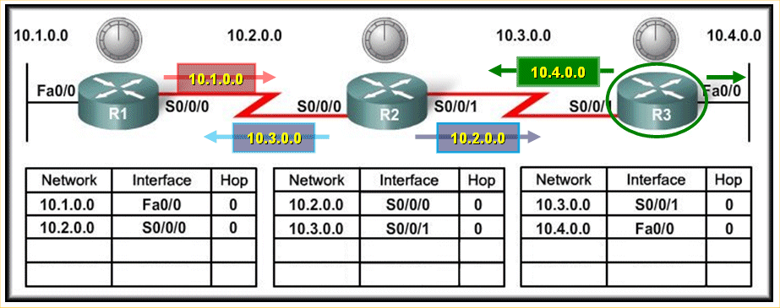
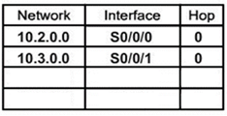
Initial Exchange of Routing Information
R1 Sends update about network 10.1.0.0 out Serial 0/0/0 interface with metric of 1.
R1 Sends update about network 10.2.0.0 out Fa0/0 interface with metric of 1.
R2 Sends update about network 10.3.0.0 out Serial 0/0/0 interface with metric of 1.
R2 Sends update about network 10.2.0.0 out Serial 0/0/1 interface with metric of 1.
R3 Sends update about network 10.4.0.0 out S0/0/0 interface with metric of 1.
R3 Sends an update about network 10.3.0.0 out Fa0/0 interface with metric of 1.

Slide 15
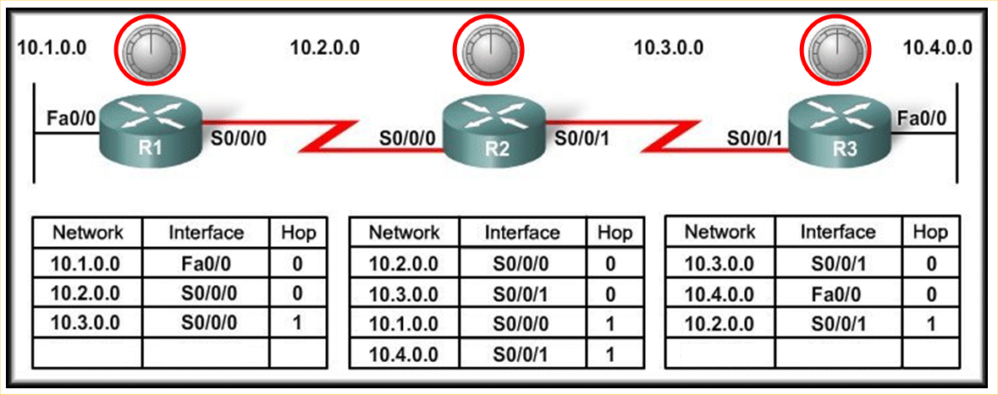
Initial Exchange of Routing Information
R1 Receives the update from R2 about network 10.3.0.0 and adds it to its routing table.
R3 Receives the update from R2 about network 10.2.0.0 and adds it to its routing table.
R2 Receives the update from R1 about network 10.1.0.0 and adds it to its routing table.
R2 Receives the update from R3 about network 10.4.0.0 and adds it to its routing table.
Now end of first round of update exchanges: Each router knows about the connected networks of its directly connected neighbors.
R1 knows about network 10.3.0.0 but not about 10.4.0.0. yet
10.3.0.0
S0/0/0
1
10.1.0.0
S0/0/0
1
10.2.0.0
S0/0/1
1
10.4.0.0
S0/0/1
1

Slide 16
Next Exchange of Routing Information R1(Periodic Updates)
When the update timers expire (Periodic Update) on R1, the routers begin the next exchange of information.
R1 sends an update about network 10.1.0.0 out the S0/0/0 interface with a metric of 1 - AGAIN!
When R2 receives the update, there is no change in information so the update is ignored.
10.1.0.0

Slide 17
Next Exchange of Routing Information R2(Periodic Updates)
When the update timers expire on R2 sends an update about networks 10.3.0.0 with a metric of 1 and 10.4.0.0 with a metric of 2 out the Serial 0/0/0 interface.
R2 sends an update about networks 10.1.0.0 with a metric of 2 and 10.2.0.0 with a metric of 1 out the Serial 0/0/1 interface.
R1 receives an update from R2 about network 10.3.0.0 and there is no change – update ignored.
R1 receives update from R2 about network 10.4.0.0 (new) and adds it to its routing table.
R3 receives an update from R2 about network 10.2.0.0 and there is no change – update ignored.
R3 receives update from R2 about network 10.1.0.0 (new) and adds it to its routing table.
NEW
NEW
10.3.0.0
10.4.0.0
10.1.0.0
10.2.0.0
10.4.0.0 S/0/0/0 2
10.1.0.0 S/0/0/0 2
The network has CONVERGED!
All routers now know about all of the networks attached to all of their neighbouring routers.

Slide 18
Routing Protocol Operating Fundamentals Achieving Convergence
Network converged when all routers have complete and accurate information about the entire network.
Convergence time is the time it takes routers to share information, calculate best paths, and update their routing tables.
A network is not completely operable until the network has converged.
Convergence properties include the speed of propagation of routing information and the calculation of optimal paths. The speed of propagation refers to the amount of time it takes for routers within the network to forward routing information.
Generally, older protocols, such as RIP, are slow to converge, whereas modern protocols, such as EIGRP and OSPF, converge more quickly.
Notes:
7.1.3.5

Slide 19
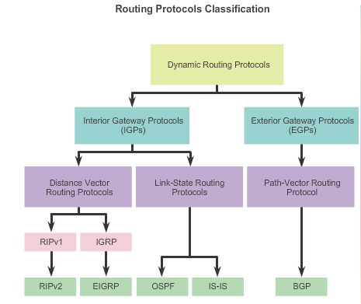
Types of Routing Protocols Classifying Routing Protocols
Within an
Organisation
Between
Organisations
Notes:
7.1.4.1

Slide 20
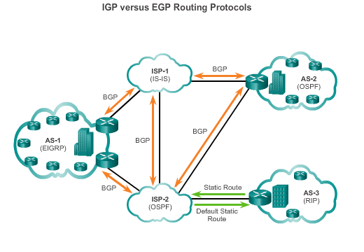
Types of Routing Protocols IGP and EGP Routing Protocols
Interior Gateway Protocols (IGP) -
Used for routing within an AS
Include RIP, EIGRP, OSPF, and IS-IS
Exterior Gateway Protocols (EGP) -
Used for routing between AS
Official routing protocol used by the Internet
Notes:
7.1.4.2

Slide 21
Types of Routing Protocols ProtocolsClassifying Routing Protocols
Two types of IGP protocols:
Distance Vector & Link State
1) Distance Vector
Routes are advertised as vectors of distance and direction.
Distance: Is defined in terms of a metric.
Hop Count: The number of routers between the source and destination networks.
Direction:Is simply the next-hop router or exit interface.
Incomplete view of network topology.
Generally, periodic updates. Routing updates usually consist of periodic updates of the entire routing table.(e.g.. Routing Information Protocol - RIP – every 30 seconds)

Slide 22
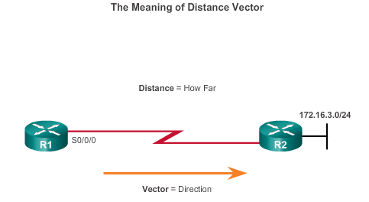
Types of Routing Protocols Distance Vector Routing Protocols
Distance vector IPv4 IGPs:
RIPv1 - First generation legacy protocol
RIPv2 - Simple distance vector routing protocol
IGRP - First generation Cisco proprietary protocol (obsolete)
EIGRP - Advanced version of distance vector routing
For R1, 172.16.3.0/24 is one hop away (distance) it can be reached through R2 (vector)
Notes:
7.1.4.3

Slide 23
Types of Routing Protocols Link-State Routing Protocols
A Link State routing protocol can create a complete map of the network topology.
A link-state router:
Receives an update.
Builds a topology database of entire network.
Uses a Shortest Path First (SPF) algorithm to create its view of the network.
Builds the routing table.
Routing updates (not the entire table) are only sent to neighbouring routers when the topology changes. (e.g.. Open Shortest Path First - OSPF)

Slide 24
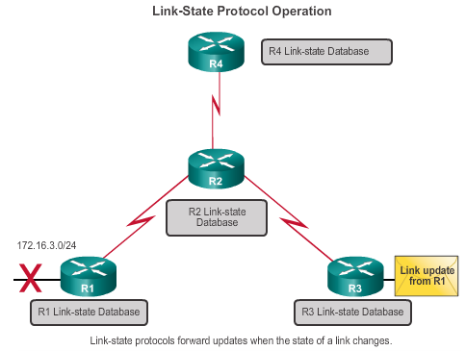
Types of Routing Protocols Link-State Routing Protocols
Link-state IPv4 IGPs:
OSPF - Popular standards based routing protocol
IS-IS - Popular in provider networks.
Notes:
7.1.4.4

Slide 25
Distance Vector v Link State
Distance Vector
The network is simple and flat and does not require a hierarchical design.
The administrators do not have enough knowledge to configure and troubleshoot link-state protocols.
Specific types of networks, such as hub-and-spoke networks, are being implemented.
Worst-case (slow) convergence times in a network are not a concern.
Link State:
The network design is hierarchical, usually occurring in large networks.
The administrators have a good knowledge of the implemented link-state routing protocol.
Fast convergence of the network is crucial.
Relatively simple, inefficient, low router processing.
More complex, more effecient, higher router processing.

Slide 26
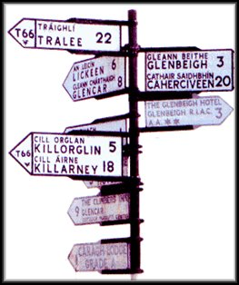
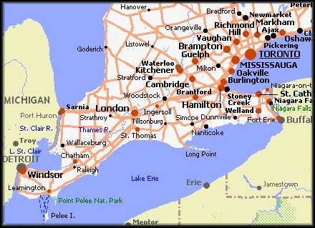
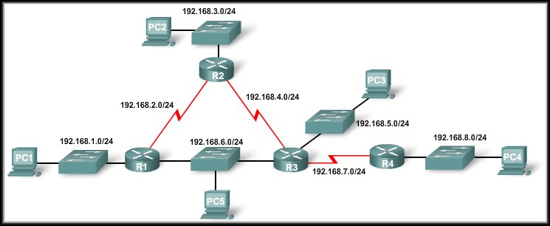
Distance Vector Link-State
R4 View of the network

Slide 27
Types of Routing Protocols Distance Vector or Link-State Routing Protocols
Distance vector protocols use routers as sign posts along the path to the final destination.
A link-state routing protocol is like having a complete map of the network topology. The sign posts along the way from source to destination are not necessary, because all link-state routers are using an identical map of the network. A link-state router uses the link-state information to create a topology map and to select the best path to all destination networks in the topology.
Notes:
7.1.4.3

Slide 28
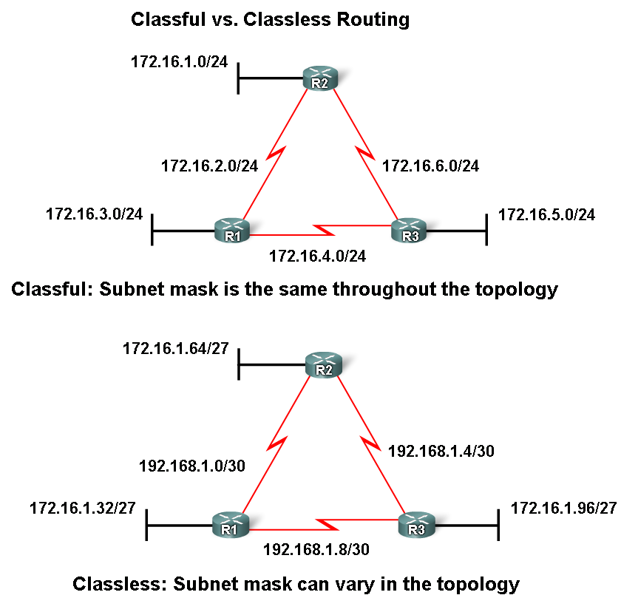
Classifying Routing Protocols Classless Classful
Classful routing protocols
Do NOT send subnet mask in routing updates.
Only RIPv1 and IGRP are classful
Cannot provide variable length subnet masks (VLSMs) and CIDR
Create problems in discontiguous networks
Classless routing protocols
Do send subnet mask in routing updates
RIPv2, EIGRP, OSPF, and IS_IS
Support VLSM and CIDR
IPv6 routing protocols

Slide 29
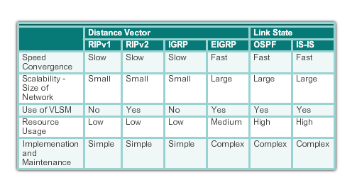
Types of Routing Protocols Routing Protocol Characteristics
Notes:
7.1.4.7

Slide 30
Types of Routing Protocols Routing Protocol Metrics
A metric is a measurable value that is assigned by the routing protocol to different routes based on the usefulness (desirability) of that route compared to another.
Used to determine the overall “cost” of a path from source to destination
Routing protocols determine the best path based on the route with the lowest cost.
There are times when a router will have multiple paths to the same destination.
Metrics are a way to measure and/or compare routes to determine which route is the best path.
Notes:
7.1.4.8

Slide 31
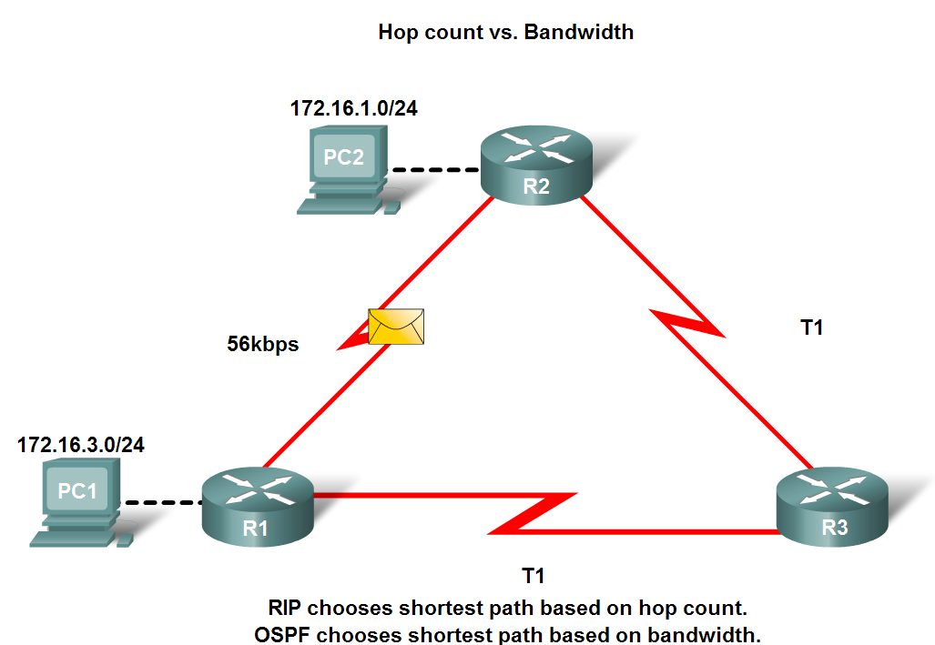
Routing Protocols Metrics
Metrics used in IP routing protocols
Bandwidth
Cost
Delay
Hop count
Load
Reliability
Metric used for each routing protocol
RIP - hop count
IGRP & EIGRP - Bandwidth (used by default), Delay (used by default), Load, Reliability
IS-IS & OSPF - Cost, Bandwidth (Cisco’s implementation)

Slide 32
Distance Vector Dynamic Routing
Notes:
7.2

Slide 33
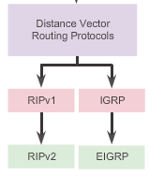
Distance Vector Routing Protocol Operation Distance Vector Technologies
Characteristics DV Routing Protocols
Share updates between neighbors
Not aware of the network topology
Some send periodic updates to broadcast IP 255.255.255.255 even if topology has not changed
Updates consume bandwidth and network device CPU resources
RIPv2 and EIGRP use multicast addresses
EIGRP will only send an update when topology has changed (triggered)
Notes:
7.2.1.1

Slide 34
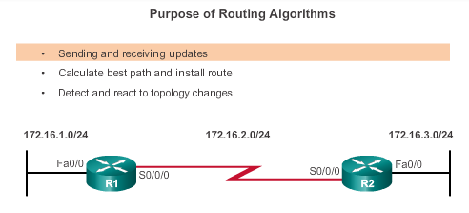
Distance Vector Routing Protocol Operation Distance Vector Algorithm
RIP uses the Bellman-Ford algorithm as its routing algorithm
IGRP and EIGRP use the Diffusing Update Algorithm (DUAL) routing algorithm developed by Cisco
Notes:
7.2.1.2

Slide 35
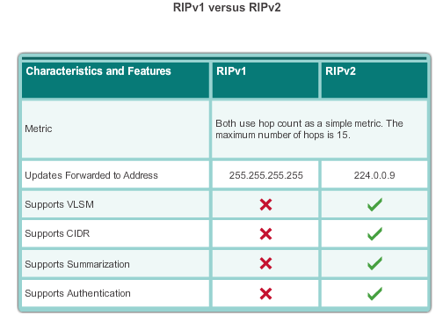
Types of Distance Vector Routing Protocols Routing Information Protocol
Routing updates broadcasted every 30 seconds
Updates use UDP port 520
RIPng is based on RIPv2 with a 15 hop limitation and the administrative distance of 120
Notes:
7.2.2.1

Slide 36
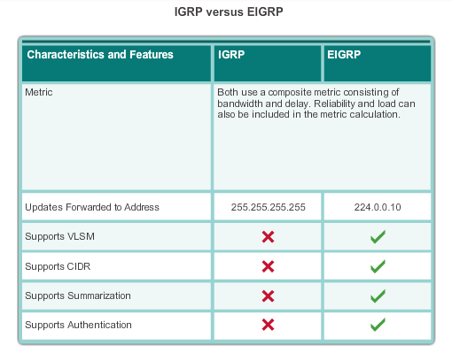
Types of Distance Vector Routing Protocols Enhanced Interior-Gateway Routing Protocol
EIGRP
Bounded triggered updates
Hello keep alives mechanism
Maintains a topology table
Rapid convergence
Multiple network layer protocol support
Notes:
7.2.2.2

Slide 37
RIP and RIPng Routing
Notes:
7.3

Slide 38
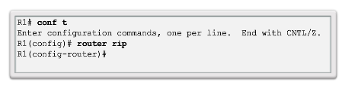
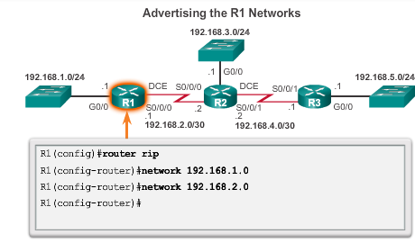
Configuring the RIP Protocol Router RIP Configuration Mode Advertising Networks
Directly connected classful addresses.
Notes:
7.3.1.1
7.3.1.2

Slide 39
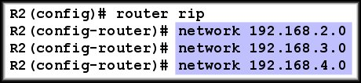
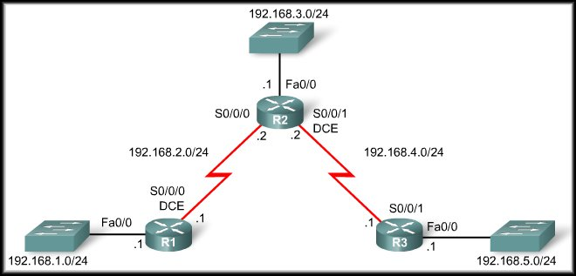


Specifying Networks
Directly connected network adresses

Slide 40
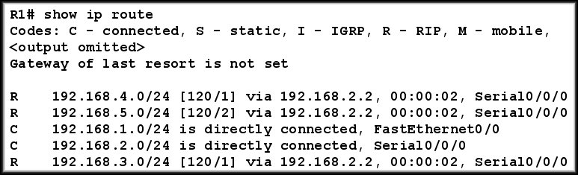
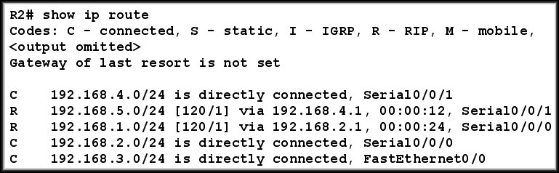
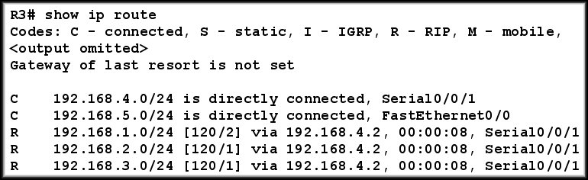
show ip route command

Slide 41
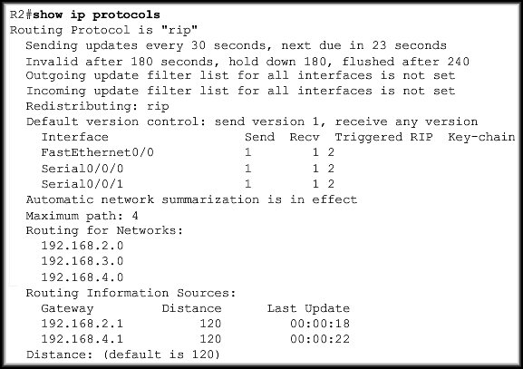
show ip protocols command
Displays routing protocol configured on router

Slide 42
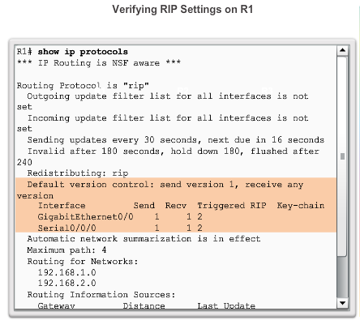
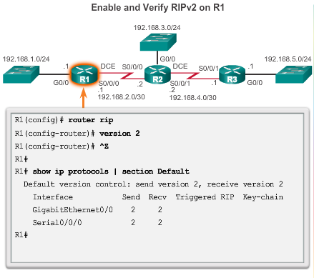
Configuring the RIP Protocol Enabling RIPv2
Notes:
7.3.1.4

Slide 43
Passive Interfaces
Some routers can have interfaces that do not connect to another router.
There is no reason to send routing updates out that interface.
You can use the passive-interface command with RIP to configure an interface to NOT send those updates.
No Router
:
Wasted Bandwidth
Wasted Resources
Security Risk
NO updates sent out interface fa0/0.

Slide 44
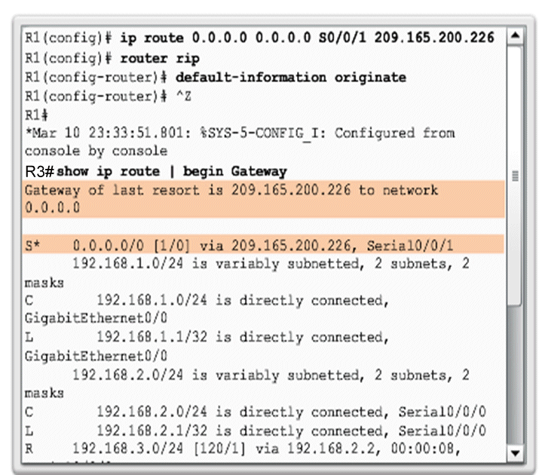
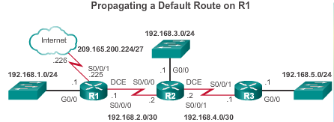
Configuring the RIP Protocol Propagating a Default Route
R1 has a default Static route to the Internet. What about R2 R3?
How does R3 forward traffic destined for the internet? It also needs a default route. We could configure a static default route on every router but this is inefficient and does not react to topology changes.
Instead, in R1, you can use default-information originate.
This command specifies that R1 (already has a default route) is to originate default information. R1 is to include the static default route in its RIP updates.
Notes:
7.3.1.7

Slide 45
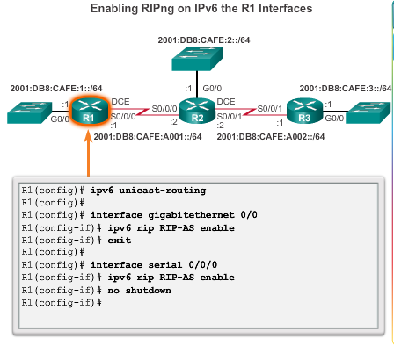
Configuring the RIPng Protocol Advertising IPv6 Networks
As with its IPv4 counterpart, RIPng is rarely used in modern networks.
It is also useful as a foundation for understanding basic network routing.
Unlike RIPv2, RIPng is enabled on an interface and not in router configuration mode.
There is no network network-address command available in RIPng.
Instead, use the ipv6 rip domain-name enable interface configuration command.
Notes:
7.3.2.1

Slide 46
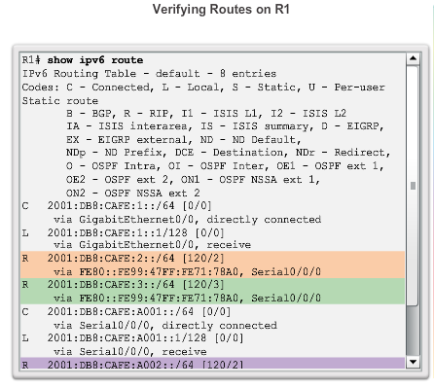
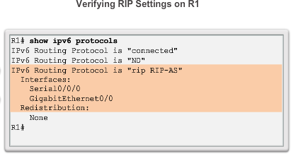
Configuring the RIPng Protocol Examining the RIPng Configuration
Notes:
7.3.2.2

Slide 47
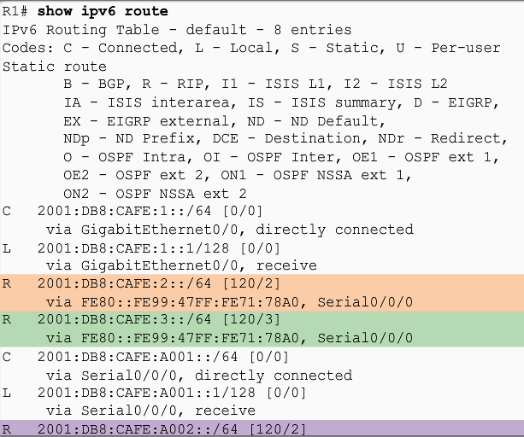
Configuring the RIPng Protocol Examining the RIPng Configuration
Notes:
7.3.2.2

Slide 48
Link-State Dynamic Routing
Notes:
7.4

Slide 49
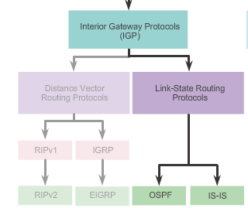
Link-State Routing Protocol Operation Shortest Path First Protocols
Notes:
7.4.1.1

Slide 50
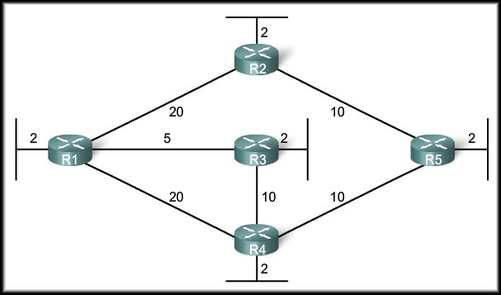
Link-State Routing Protocol Operation Dijkstra’s Algorithm
Dijkstra’s algorithm is commonly referred to as the Shortest Path First (SPF) algorithm.
This algorithm accumulates costs along each path, from source to destination.
We will see that Cisco's implementation of OSPF specifies the cost of the link (the OSPF routing metric) as the bandwidth of the outgoing interface.

Slide 51
Introduction to the SPF Algorithm
To illustrate how SPF operates, each path in the figure is labeled with an arbitrary value for cost.
Each router calculates the SPF algorithm and determines the cost of a link from its own perspective.
For example: R1 to send packets to the LAN attached to R5.
Option 1: R1 to R4 to R5 is 32 (20 + 10 + 2 = 32).
Option 2: R1 to R3 to R4 to R5 is 27 (5 + 10 + 10=2 = 27).
Option 2 will be chooses because despite having a bigger hop count it’s the “least cost” option.

Slide 52
Link-State Routing Process
How does a link-state routing protocol work?
5 Step Process:
Each router learns about its own directly connected networks.
Each router is responsible for contacting its neighbors on directly connected networks.
Each router builds a link-state packet (LSP) containing the state of each directly connected link.
Each router floods the LSP to all neighbors, who then store all LSPs received in a database.
Each router uses the LSPs to construct a database that is a complete map of the topology and computes the best path to each destination network.

Slide 53
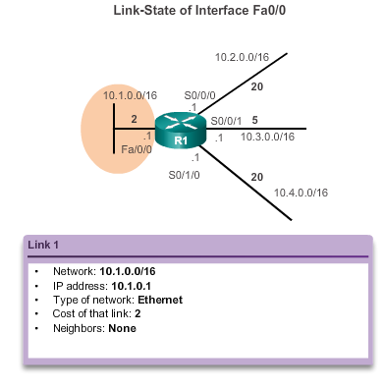
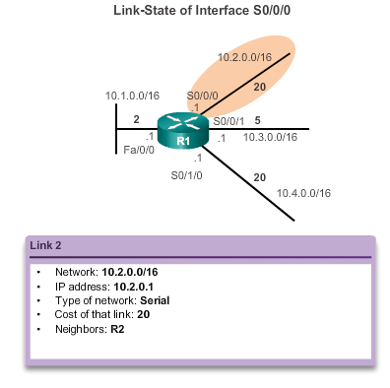
Link-State Updates Link and Link-State
The first step in the link-state routing process is that each router learns about its own links, its own directly connected networks.
Notes:
7.4.2.2

Slide 54
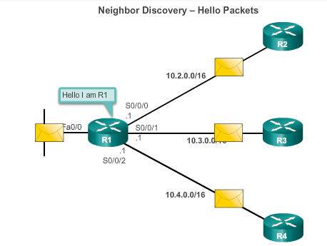
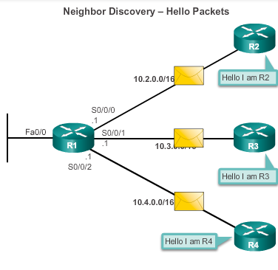
Link-State Updates Say Hello
The second step in the link-state routing process is that each router is responsible for meeting its neighbors on directly connected networks.
Note: Neighbors will only reply if they are also running the same LS protocol
Notes:
7.4.2.3

Slide 55
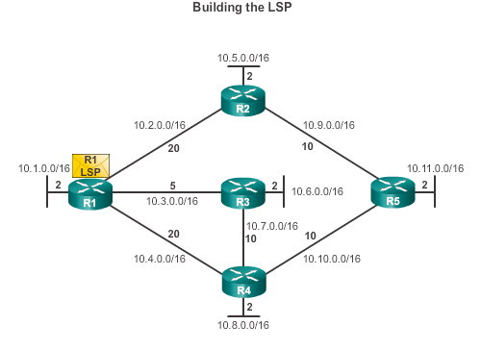
Link-State Updates Say Hello
The third step in the link-state routing process is that each router builds a link-state packet (LSP) containing the state of each directly connected link.
R1; Ethernet network 10.1.0.0/16; Cost 2
R1 -> R2; Serial point-to-point network; 10.2.0.0/16; Cost 20
R1 -> R3; Serial point-to-point network; 10.7.0.0/16; Cost 5
R1 -> R4; Serial point-to-point network; 10.4.0.0/16; Cost 20
Notes:
7.4.2.4

Slide 56
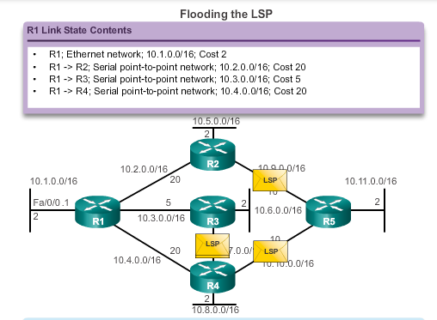
Link-State Updates Flooding the LSP
The fourth step in the link-state routing process is that each router floods the LSP to all neighbors, who then store all LSPs received in a database.
Notes:
7.4.2.5

Slide 57
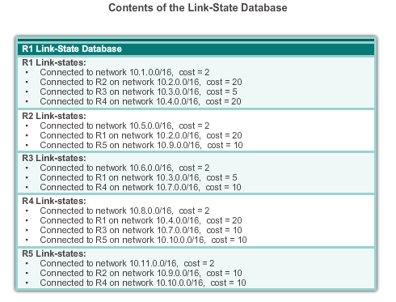
Link-State Updates Building the Link-State Database
The final step in the link-state routing process is that each router uses the database to construct a complete map of the topology and computes the best path to each destination network.
Notes:
7.4.2.6

Slide 58
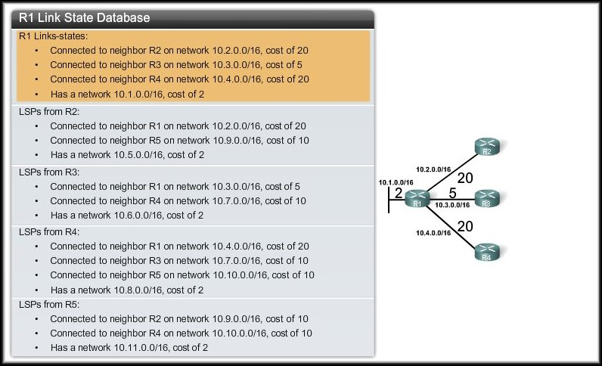
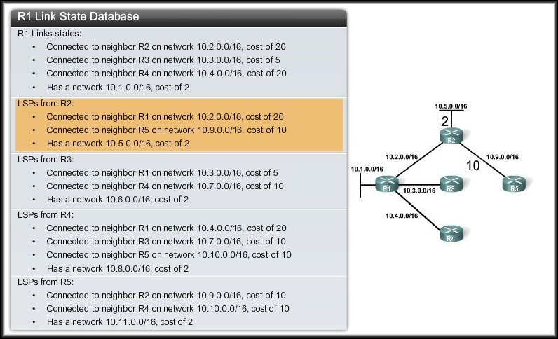



R1: Building the SPF Tree

Slide 59

Link-State Updates Building the SPF Tree
Notes:
7.4.2.7

Slide 60

Link-State Updates Adding OSPF Routes to the Routing Table
Notes:
7.4.2.8

Slide 61

Why Use Link-State Routing Protocols Why Use Link-State Protocols?
Disadvantages compared to distance vector routing protocols:
Memory Requirements
Processing Requirements
Bandwidth Requirements
Notes:
7.4.3.1

Slide 62
Requirements: Link-State
Memory Requirements Link-state routing protocols typically require more memory, more CPU processing and, at times, more bandwidth than distance vector routing protocols. The memory requirements are because of the use of: Link-state databases. Creation of the SPF tree.
Processing Requirements:
Link-state protocols can also require more CPU processing than distance vector routing protocols. The SPF algorithm requires more CPU time than distance vector algorithms because link-state protocols build a complete map of the topology.
Bandwidth Requirements:
The flooding of link-state packets can adversely affect the available bandwidth on a network.
However this should only occur during initial startup of routers, but it can also be an issue on unstable networks.

Slide 63

Why Use Link-State Routing Protocols Link-State Protocols: Areas
Link-state routing protocols such as OSPF and IS-IS use the concept of areas.
Multiple areas create a hierarchical design to networks, allowing better route aggregation (summarization) and the isolation of routing issues within an area.
Notes:
7.4.3.2

Slide 64
Comparison: Link-State
There are two link-state routing protocols used for routing today:
Open Shortest Path First (OSPF)
Intermediate System to Intermediate System (IS-IS)
OSPF was designed by the IETF (Internet Engineering Task Force) OSPF Working Group. It which still exists today. The development of OSPF began in 1987 and there are two current versions in use:OSPFv2: for IPv4 networks & OSPFv3: for IPv6.
IS-IS was designed by the ISO (International Organization for Standardization). IS-IS was originally designed for the OSI protocol suite. Later, Integrated IS-IS, or Dual IS-IS, included support for IP networks Although IS-IS has been known as the routing protocol used mainly by ISPs and carriers, more enterprise networks are beginning to use IS-IS.

Slide 65
The Routing Table
Notes:
7.4

Slide 66

Routing Table Entries
Routing table entries from the following sources:
Directly connected networks. (C)
Static routes. (S)
Dynamic routing protocols. (R)
The routing table hierarchy in Cisco IOS software was originally implemented with the classful routing scheme.
It incorporates both classful and classless addressing but the overall structure is still built around this classful scheme.

Slide 67

Parts of an IPv4 Route Entry Remote Network Entries
Elapsed time since last update.
Identifies RIP as the source of the route.
Remote network address and subnet mask.
AD of 120 / Metric of 2 hops.
Address of the next-hop router.
Notes:
7.5.1.3

Slide 68

Dynamically Learned IPv4 Routes Routing Table Terms
Routes are discussed in terms of:
Ultimate route
Level 1 route
Level 1 parent route
Level 2 child routes
Notes:
7.5.2.1

Slide 69
Dynamically Learned IPv4 Routes Ultimate Route
An ultimate route is a routing table entry that contains either a next-hop IP address or an exit interface.
Directly connected, dynamically learned, and link local routes are ultimate routes.
Notes:
7.5.2.2

Slide 70

Level 1 Routes
A level 1 route is a route with a subnet mask equal to or less than the classful mask of the network address (i.e. not a subnet).
Example:
192.168.1.1 is a Class C address.
Classful Mask – 255.255.255.0 or /24.
192.168.1.0/24 is a level 1 network route because the subnet mask is equal to the network’s classful mask.

Slide 71

Level 1 Routes
Mask= Default /24
Mask is less than /24
Default Route
A Level 1 route can function as any of the following:
Default Route: A static route with the address 0.0.0.0 / 0.
Supernet Route: Mask less than the classful mask.(i.e. aSummarized Route)
Network Route: A route that has a subnet mask equal to that of the classful mask.

Slide 72

Parent and Child Routes

Slide 73

Parent and Child Routes
Parent Route
A Level 1 Parent Route has Two entries in the routing table.
When the 172.16.3.0 subnet was added to the routing table, another route (172.16.0.0) was also added.
This first entry does not contain any next-hop IP address or exit interface information.
A Level 2 route is a route that is a subnet of a network address.
The source of a level 2 route can be a directly connected network, a static route, or a dynamic routing protocol.
A Level 2 route is also knows as a Child Route.

Slide 74

Adding Another Child Route
Ultimate Routes
Both 172.16.2.0 and 172.16.3.0 are members of the same parent route because they are both members of the 172.16.0.0/16 classful network.
Because both child routes have the same subnet mask, the parent route still maintains the /24 mask but now shows two subnets.

Slide 75

Parent and Child Routes: Classless Networks
Ultimate Routes

Slide 76
The IPv4 Route Lookup Process
The router examines level 1 network routes for the best match with the destination address of the IPv4 packet. If the best match is a level 1 ultimate route, then this route is used to forward the packet. If the best match is a level 1 parent route, proceed to the next step.
The router examines child routes (the subnet routes) of the parent route for a best match. If there is a match with a level 2 child route, that subnet is used to forward the packet. If there is not a match with any of the level 2 child routes, proceed to the next step.
The router continues searching level 1 supernet routes in the routing table for a match, including the default route, if there is one. If there is now a lesser match with a level 1 supernet or default routes, the router uses that route to forward the packet.If there is not a match with any route in the routing table, the router drops the packet.

Slide 77




Slide 78

Longest Match: Level 1 Network Routes
Note: All less than /16
3 Summarized
Routes.
For there to be a match between the destination IP address of a packet and a route in the routing table, a minimum number of leftmost bits must match between the IP address of the packet and the route in the routing table.
The subnet mask of the summerizid route in the routing table is used to determine the minimum number of leftmost bits that must match.

Slide 79
Longest Match: Level 1 Network Routes
The IPv4 Route Lookup Process Best Route = Longest Match
The best match or longest match is the route in the routing table that has the greatest number of leftmost matching bits with the destination IP address of the packet.
Preferred Route:
The route with the greatest number of equivalent leftmost bits, or the longest match.

Slide 80


Analyze an IPVv6 Routing Table Directly Connected Entries
Components of the IPv6 routing table are very similar to the IPv4 routing table. For instance, it is populated using directly connected interfaces, static routes, and dynamically learned routes.
Notes:
7.5.4.2

Slide 81


Analyze an IPVv6 Routing Table Remote IPv6 Network Entries
Notes:
7.5.4.3

Slide 82


